Slide 1
Kinematics Presentation Tom
3_27_25

Slide 2
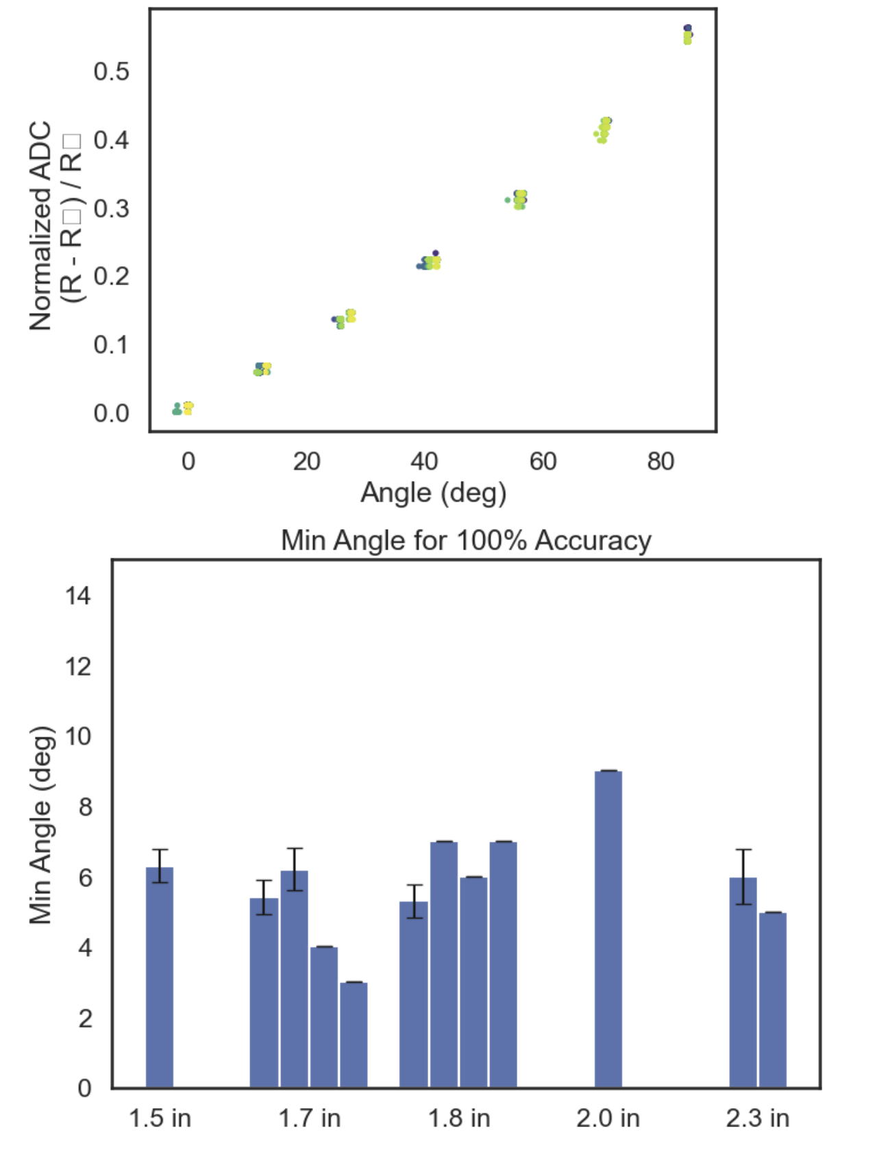
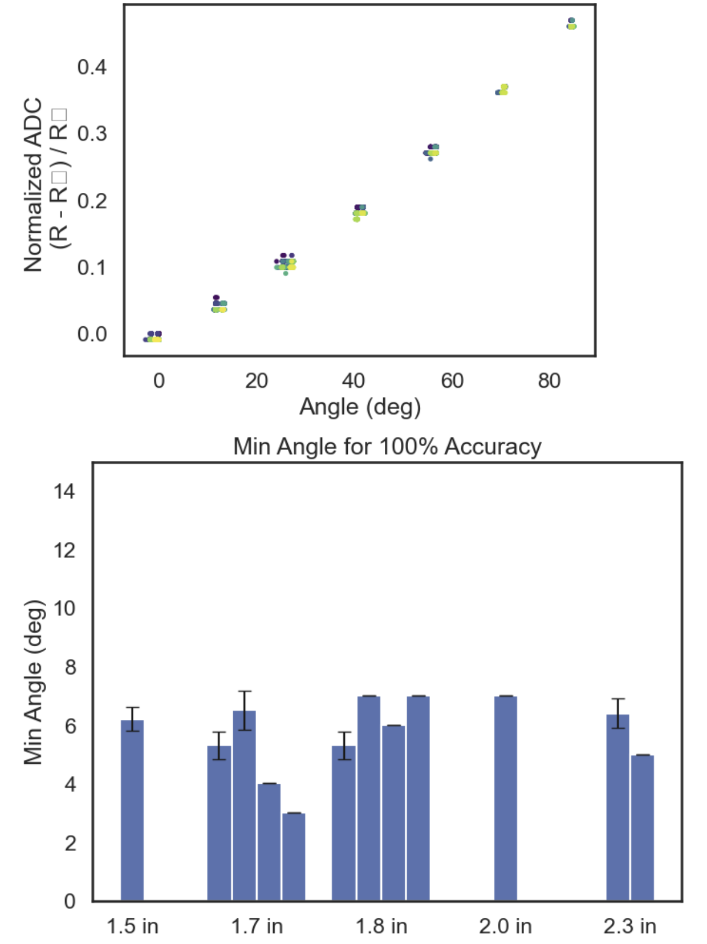
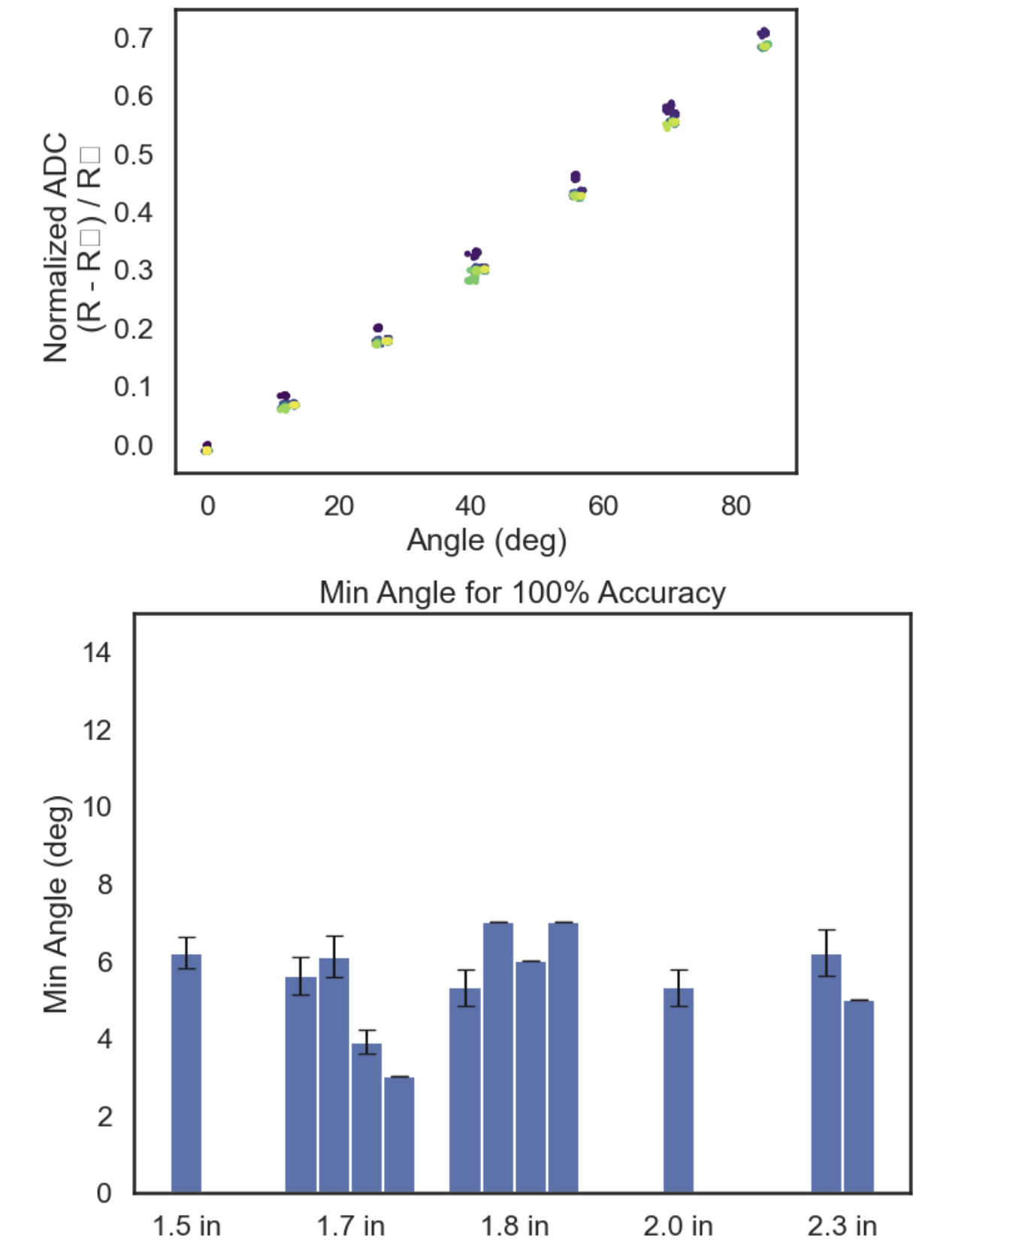
~0.67V source, 16 bit enc, 8x ADC gain, 100 ohm div
Just Re-testing previous
3.3V source, 16 bit enc, 8x ADC gain, 50 ohm div

Slide 3
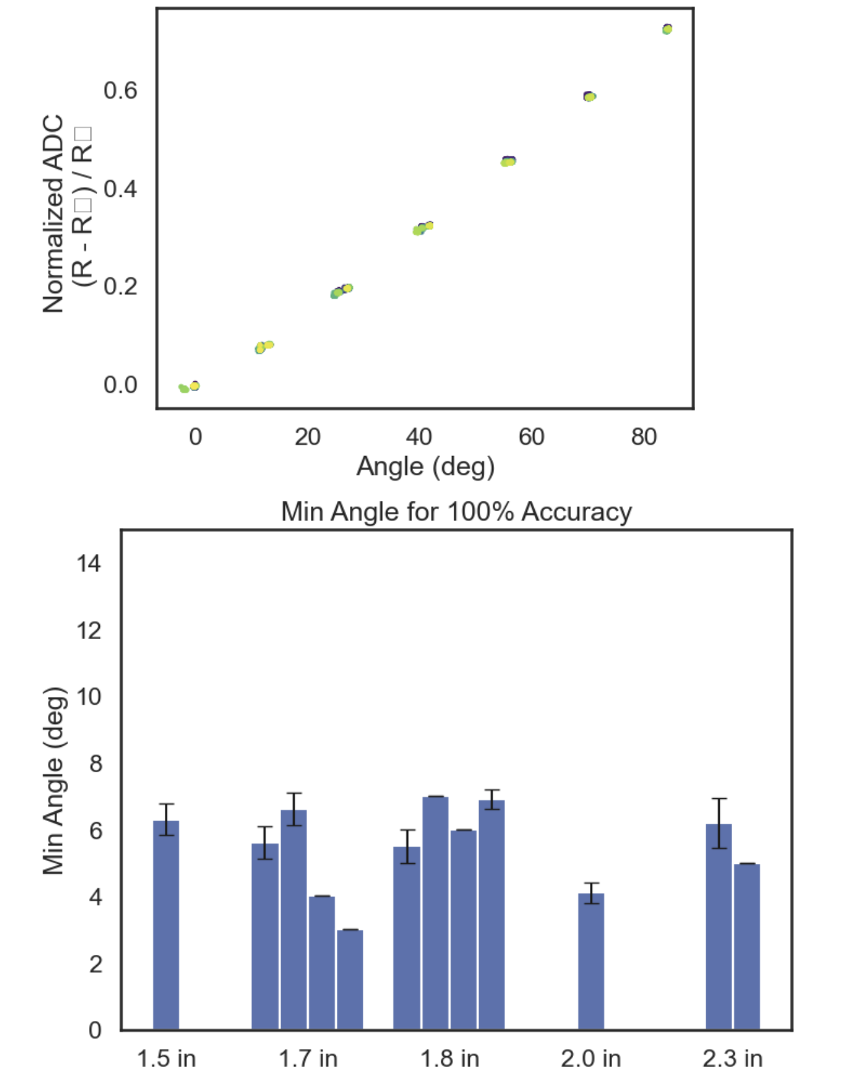
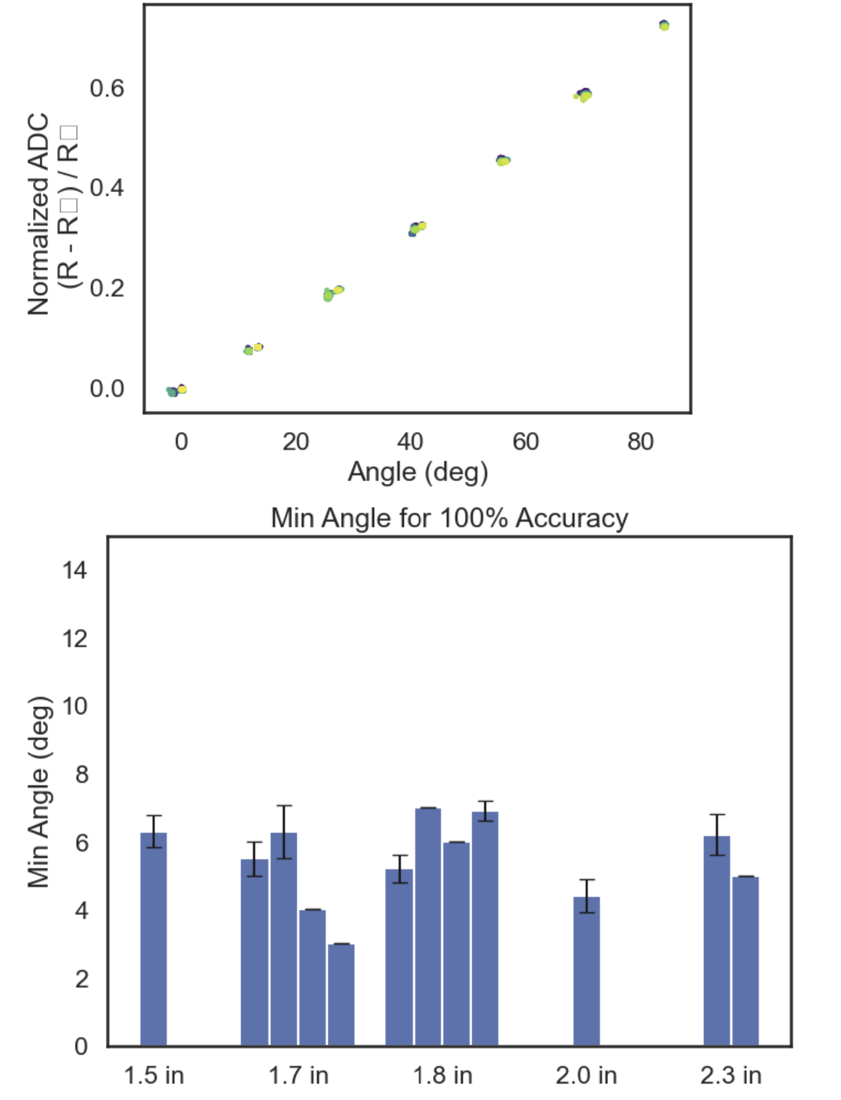
3.3V source from LVR and 2 x 10uF Caps, 16 bit enc, 8x ADC gain, 50 ohm div
3.3V source from LVR and 2 10uF Caps, 16 bit enc, 8x ADC gain, 40 ohm div (~15% of possible ADC range)
3.3V source, 16 bit enc, 8x ADC gain, 50 ohm div

Slide 4
Kinematics Presentation Tom
4_9_25

Slide 5
Circuit V1 Option
50 ohm
Strain Gauge (0.4 ohm – 0.8ohm)
LVR +3.3V
+26 mV to 52 mV
+0 mV
GND
x76
LMC6482, 75kohm/1kohm, total gain of 76
LM040, 2.048V ref
GND
+1.98 V to 3.95V
-2.048 V
x2
MCP3421 Differential Input PGA x2, 16 bit
(Alternative can use ADS111)
Arduino Uno I2C
ADC bits range from ~ -3000 to 20000 of possible -32k to 32 k

Slide 6
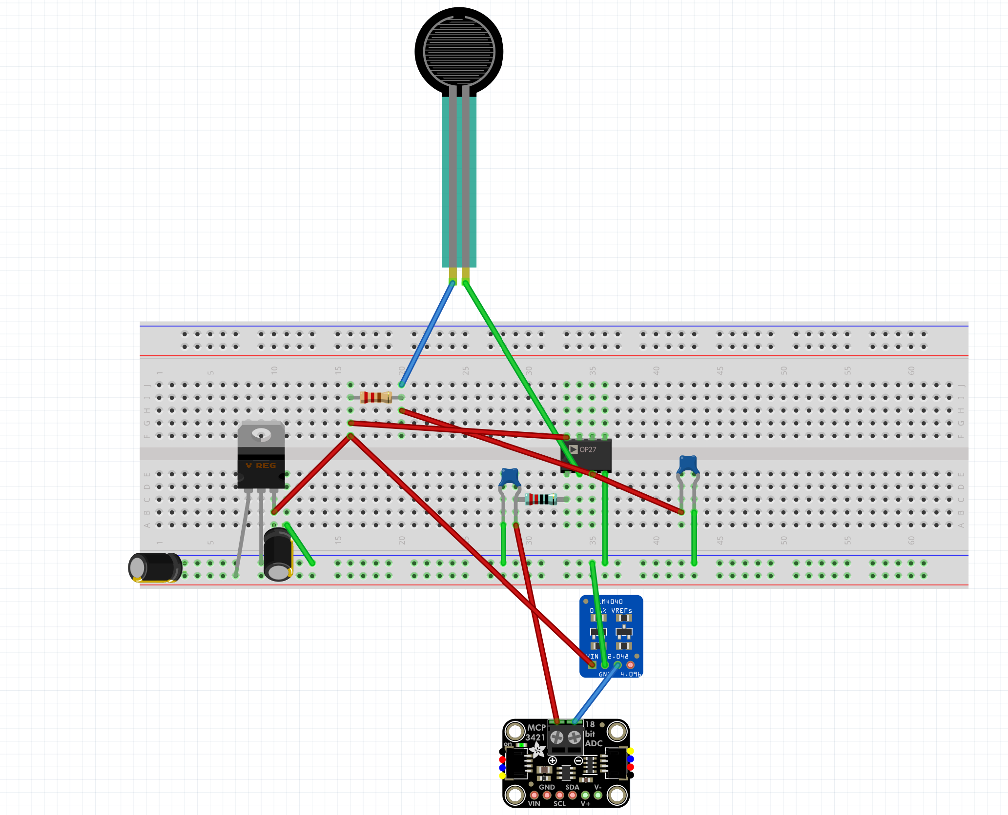
1 uF
1k ohm
50 ohm
LVR 3.3 V from 5V Arduino Uno
10 uF
0.1 uF

Slide 7
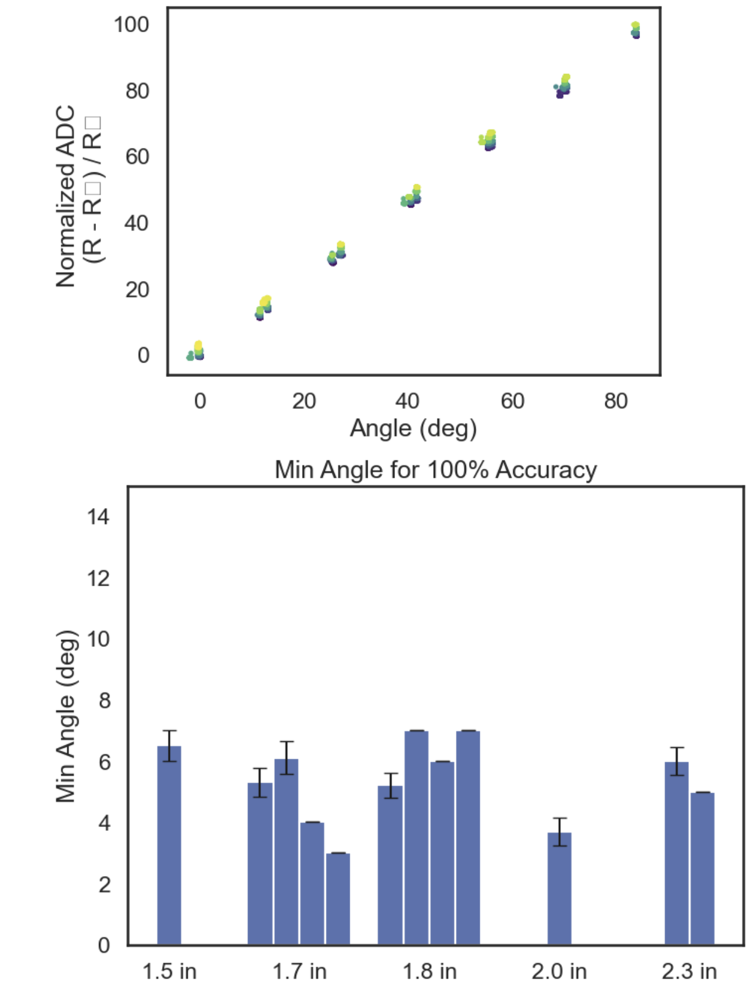
3.3V source from LVR and 2 x 10uF Caps, 16 bit enc, 8x ADC gain, 50 ohm div
3.3V source from LVR and 2 x 10uF Caps, 16 bit enc, 2x ADC gain (using diff input), 76x gain from LMC6482 (across gauge), 50 ohm div with 0.4 ohm strain gauge (see circuit)

Slide 8
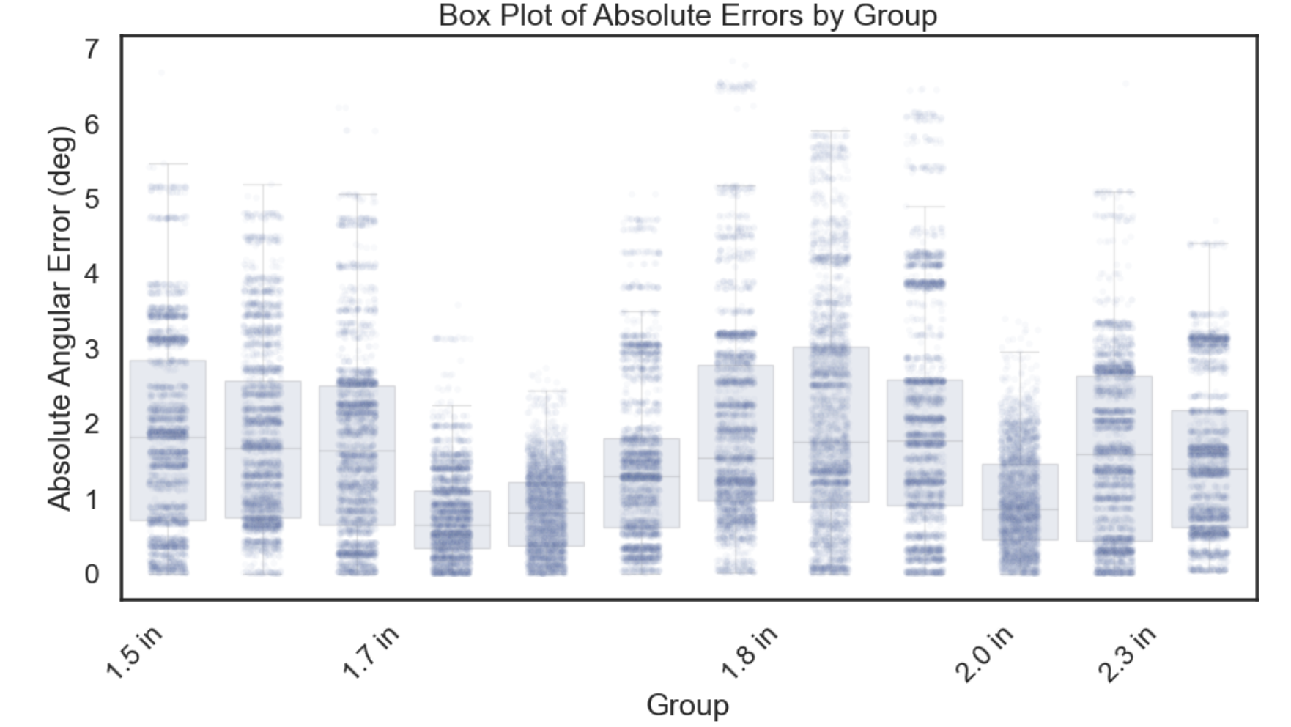

Slide 9
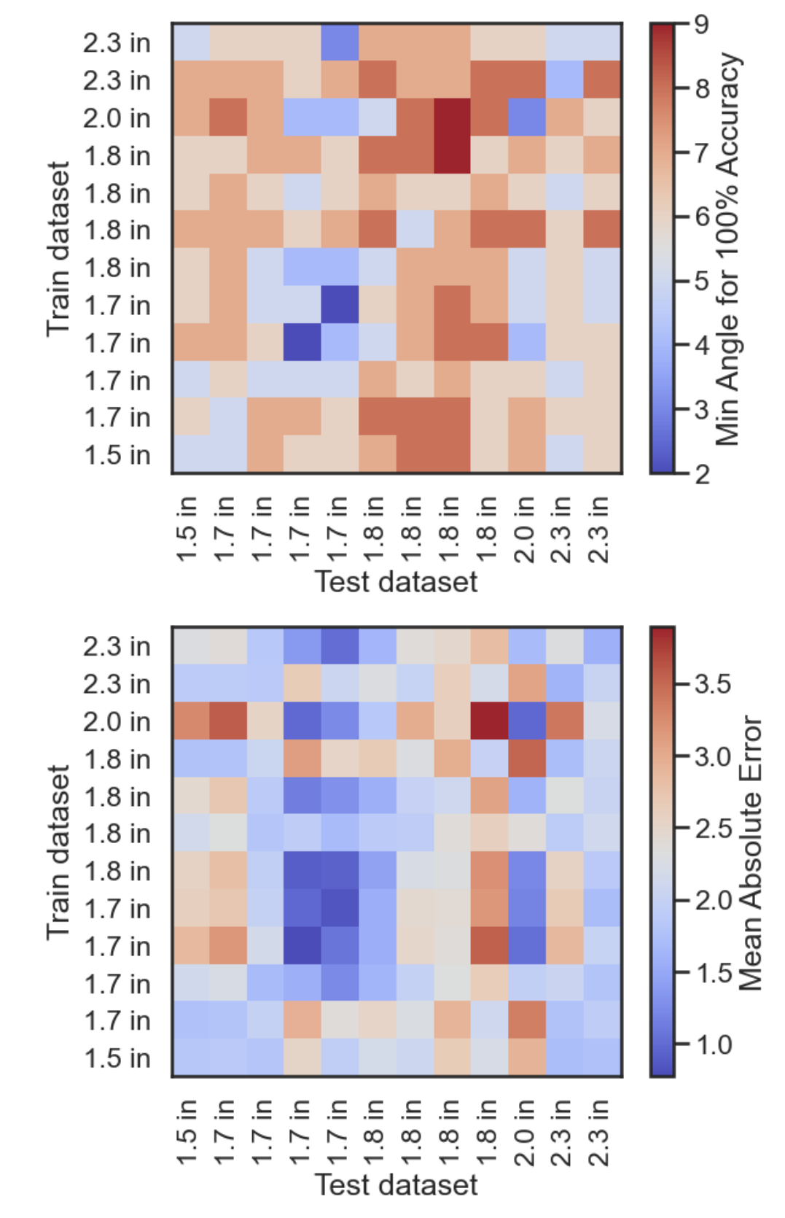

Slide 10
Circuit V2 Option (IDEAL)
Strain Gauge (0.4 ohm – 0.8ohm)
1kohm
GND
+1.3 mV to 2.6 mV
~ - 1.95 mV ref (average of input voltage range)
LVR +3.3V
X?
ADS112C04 16-Bit, 4-Channel, 2-kSPS, Delta-Sigma ADC With I2C Interface, 128x Gain!
GND
Microcontroller

Slide 11
Circuit V3 Option
Strain Gauge (0.4 ohm – 0.8ohm)
50 ohm
LM040, 2.048V ref
GND
LVR +3.3V
+26 mV to 52 mV + 2.048V
- 2.048 V ref
X?
ad620 inst. Amp. ?x Gain, Vref = 0 V
GND
12 bit ADC, single ended input

